Slide 1
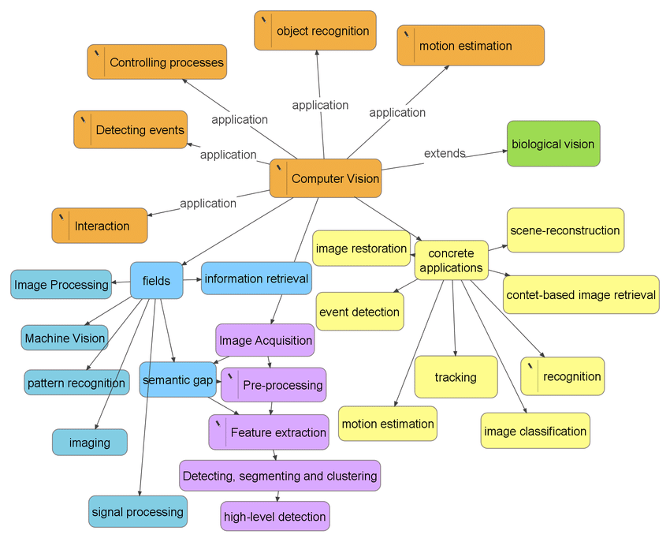
Computer vision

Slide 2
Image classification: class
Object localization : location of object + class
Object detection : location + confidence score + class
Object recognition: Similarity score + class(name)
Object Segmentation :
Action Recognition :
Augmentation :
Object Tracking :
Image : matrix of pixels
Video: FPS

Slide 3
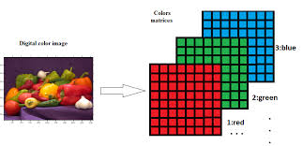
Image : Arrangement of pixels ("picture element," is the smallest unit of a digital image that can be displayed and manipulated on a screen.)
RGB Channels:
Red: (255, 0, 0)
Green: (0, 255, 0)
Blue: (0, 0, 255)
White: (255, 255, 255)
Black: (0, 0, 0)
Gray Scale : black & white : 1
Resolution : 1080*1080 pixels
Image:width*height*channels(3: RGB , 1: Gray Scale)
5*10*3
Video: collections of image frame
7mb= 7000000*7000000*3=
Fps: Frames per second

Slide 4
Image Processing (OpenCV)
1. Basic Image Operations
Loading and Displaying Images: cv2.imread(), cv2.imshow(), cv2.imwrite()
Resizing: cv2.resize()
Rotating and Flipping: cv2.rotate(), cv2.flip()
Cropping: Selecting a region of interest (ROI) using array slicing.
2. Color Space Conversions
Grayscale Conversion: cv2.cvtColor(image, cv2.COLOR_BGR2GRAY)
HSV, LAB, and YCrCb Color Spaces: cv2.cvtColor(image, cv2.COLOR_BGR2HSV), cv2.cvtColor(image, cv2.COLOR_BGR2LAB), etc.
Splitting and Merging Channels: cv2.split() and cv2.merge()
3. Image Filtering and Smoothing
Blurring (Averaging): cv2.blur(image, (k, k))
Gaussian Blurring: cv2.GaussianBlur(image, (k, k), sigmaX)
Median Blurring: cv2.medianBlur(image, k)
Bilateral Filtering: cv2.bilateralFilter(image, d, sigmaColor, sigmaSpace)
4. Thresholding( convert into grayscale by threshold)
Simple Thresholding: cv2.threshold(image, thresh, maxVal, type)
Adaptive Thresholding: cv2.adaptiveThreshold(image, maxVal, adaptiveMethod, thresholdType, blockSize, C)
Otsu’s Binarization: cv2.threshold(image, 0, 255, cv2.THRESH_BINARY + cv2.THRESH_OTSU)

Slide 5
5. Edge Detection
Canny Edge Detection: cv2.Canny(image, threshold1, threshold2)
Sobel and Scharr Derivatives: cv2.Sobel(image, ddepth, dx, dy, ksize)
Laplacian Operator: cv2.Laplacian(image, ddepth)
6. Morphological Operations
Erosion and Dilation: cv2.erode(), cv2.dilate()
Opening and Closing: cv2.morphologyEx(image, cv2.MORPH_OPEN, kernel), cv2.morphologyEx(image, cv2.MORPH_CLOSE, kernel)
Gradient, Top Hat, and Black Hat Transformations: cv2.morphologyEx(image, type, kernel)
7. Image Transformation
Affine Transformations: cv2.warpAffine(image, M, (cols, rows))
Perspective Transformations: cv2.getPerspectiveTransform(pts1, pts2), cv2.warpPerspective(image, M, (cols, rows))
Translation and Scaling: Using transformation matrices for translation or scaling.
8. Contour Detection and Analysis
Finding Contours: cv2.findContours()
Drawing Contours: cv2.drawContours()
Contour Properties: Area (cv2.contourArea()), Perimeter (cv2.arcLength()), Moments (cv2.moments())

Slide 6
9. Image Histogram Analysis
Calculating Histograms: cv2.calcHist()
Histogram Equalization: cv2.equalizeHist()
CLAHE (Contrast Limited Adaptive Histogram Equalization): cv2.createCLAHE()
10. Feature Detection and Matching
Keypoint Detection: SIFT (cv2.SIFT_create()), SURF, ORB (cv2.ORB_create())
Feature Matching: cv2.BFMatcher() and cv2.FlannBasedMatcher()
Template Matching: cv2.matchTemplate(image, template, method)
11. Object Detection
Haar Cascade Classifier: cv2.CascadeClassifier()
Background Subtraction: cv2.createBackgroundSubtractorMOG2(), cv2.createBackgroundSubtractorKNN()
12. Image Segmentation
Watershed Algorithm: cv2.watershed()
GrabCut Algorithm: cv2.grabCut()
K-Means Clustering for Segmentation: cv2.kmeans()
13. Geometric Transformations and Affine Transformations
Rotation, Scaling, and Shearing: Using affine transformation matrices.
Perspective Transform: Warping images using points.

Slide 7
14. Drawing Shapes and Text
Draw Basic Shapes: cv2.line(), cv2.rectangle(), cv2.circle(), cv2.ellipse()
Draw Polygons: cv2.polylines()
Adding Text: cv2.putText(image, text, position, font, fontScale, color, thickness)
15. Image Blending and Masking
Blending: Combining images with cv2.addWeighted()
Masking: Using binary masks to apply operations selectively.

Slide 8
Why CNN for Images
ANN will take huge amount of time to process due to matrix multiplication
Overfitting issue in ANN for Images
Spatial feature loss

Slide 9
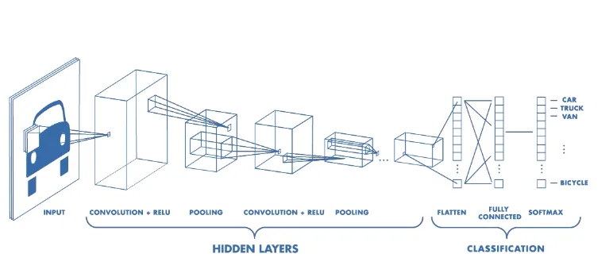
CNN (Convolutional neural networks) : convolve
https://poloclub.github.io/cnn-explainer/
https://deeplizard.com/resource/pavq7noze2

Slide 10
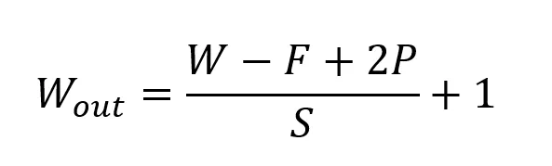
Convolutional Layer
Purpose: The core layer of CNNs, convolutional layers apply filters (kernels) to the input image or feature maps to detect local features, such as edges, textures, and patterns.
Operation: Each filter slides over the input data, performing a dot product to produce feature maps.
Parameters: Number of filters (kernels), kernel size, stride (step size of the filter movement), and padding (adding pixels around the input image to control output size).
input of size W x W x D
F: filter/kernel size
P: Padding
S: Stride 28*28*3……w=28, f=3, P=2, s: 2…….wout : 15
Activation Layer (ReLU)
Purpose: Activation functions introduce non-linearity to allow the model to learn complex patterns.
Common Activation: Rectified Linear Unit (ReLU), defined as f(x)=max⁡(0,x)f(x) = \max(0, x)f(x)=max(0,x).
Effect: ReLU zeroes out all negative values in the feature map, which helps prevent issues like vanishing gradients and accelerates training.

Slide 11
Pooling Layer (Downsampling)
Purpose: Pooling layers reduce the spatial dimensions of feature maps, which reduces the computational load and helps make the model more robust to small translations or distortions in the image.
Types of Pooling:
  Max Pooling: Takes the maximum value from each window, commonly used as it retains the strongest features.
  Average Pooling: Averages values in each window, used less frequently in CNNs.
Example: A 2x2 max pooling with stride 2 reduces the dimension of a 4x4 feature map to 2x2 by selecting the max value in each 2x2 window.
Fully Connected (Dense) Layer
Purpose: The fully connected layer is usually found at the end of a CNN architecture. It combines all the features learned in previous layers to make final predictions or classifications.
How it Works: The output from the last pooling or convolutional layer is flattened into a 1D vector, then fed into one or more fully connected layers. Each neuron in a fully connected layer is connected to every neuron in the previous layer, allowing the network to learn complex associations.
Example: In a CNN that classifies images, the last fully connected layer might have as many neurons as there are classes in the dataset, each producing a probability for each class (usually achieved using a softmax activation).

Slide 12
Softmax Layer (Output Layer)
Purpose: For classification problems, the softmax layer is typically the last layer, as it converts the network's final scores (logits) into probabilities.
Effect: It outputs a probability distribution for each class, making it suitable for multi-class classification.
Example: A softmax layer for an image classification problem with 10 classes will produce a vector of 10 probabilities that sum up to 1.
Normalization Layer (Batch Normalization)
Purpose: Batch normalization standardizes the outputs of a layer to improve training stability and speed.
How it Works: It normalizes each feature map based on the mini-batch’s mean and variance, making the training process faster and helping prevent issues like vanishing or exploding gradients.
Example: In practice, batch normalization is often added after convolutional layers, before the activation function, to keep activations within a stable range and enable faster convergence.
Dropout Layer
Purpose: Dropout is a regularization technique used to prevent overfitting by randomly "dropping out" (setting to zero) a percentage of neurons during training.
Effect: This layer encourages the network to learn more robust and generalizable features, as it forces the model not to rely on any single neuron.
Example: A dropout rate of 0.5 means half of the neurons are randomly deactivated in each forward pass.

Slide 13
CV Model/Networks
1. LeNet (1998)
Overview: LeNet-5 was one of the first CNNs used for digit classification (e.g., MNIST).
Pros:
  Efficient and effective for small-scale image classification tasks.
  Pioneered convolutional layers, max pooling, and fully connected layers.
Cons:
  Too simplistic for complex tasks like object detection or high-resolution image classification.
How it Works: Uses two convolutional layers followed by pooling and fully connected layers.
from tensorflow.keras import datasets, layers, models
model = models.Sequential([
layers.Conv2D(6, (5, 5), activation='relu', input_shape=(32, 32, 1)),
layers.AvgPool2D(),
layers.Conv2D(16, (5, 5), activation='relu'),
layers.AvgPool2D(),
layers.Flatten(),
layers.Dense(120, activation='relu'),
layers.Dense(84, activation='relu'),
layers.Dense(10, activation='softmax

Slide 14
2. AlexNet (2012)
Overview: A breakthrough model that won the ImageNet competition with a large margin.
Pros:
  First model to utilize ReLU activations and dropout for regularization.
  Successfully demonstrated the power of deep CNNs with GPUs.
Cons:
  High computational cost due to the model’s size and fully connected layers.
How it Works: Uses five convolutional layers followed by max pooling and three fully connected layers.
from tensorflow.keras.applications import AlexNet
model = AlexNet(weights='imagenet')
Note : Add Architecture, Github page/ paper

Slide 15
VGG (2014)
Overview: A deep network that introduced smaller filters (3x3) but used a deeper structure.
Pros:
  Easy to generalize and transfer to other tasks.
  Standardized use of 3x3 convolutions is effective.
Cons:
  High computational and memory requirements.
How it Works: Sequential layers with 3x3 filters, followed by max pooling and dense layers.
from tensorflow.keras.applications import VGG16
model = VGG16(weights='imagenet')

Slide 16
GoogLeNet / Inception (2014)
Overview: Known for the "Inception module," which used multiple filter sizes for each layer.
Pros:
  Efficient due to the combination of different-sized filters.
  Less computation compared to VGG while maintaining accuracy.
Cons:
  Complex structure makes it challenging to modify.
How it Works: Inception modules use 1x1, 3x3, and 5x5 convolutions in parallel.
from tensorflow.keras.applications import InceptionV3
model = InceptionV3(weights='imagenet')

Slide 17
ResNet (2015)
Overview: ResNet introduced residual connections, solving the vanishing gradient problem.
Pros:
  Very deep networks (e.g., ResNet-50, ResNet-152) are feasible due to skip connections.
  Excellent for transfer learning.
Cons:
  Large model size.
How it Works: Adds "skip connections" to allow gradients to flow through the network more easily.
Code:
from tensorflow.keras.applications import ResNet50
model = ResNet50(weights='imagenet')

Slide 18
DenseNet (2016)
Overview: DenseNet connects each layer to every other layer in a feed-forward manner.
Pros:
  Encourages feature reuse, leading to parameter efficiency.
Cons:
  High memory usage.
How it Works: Dense connections concatenate outputs of previous layers rather than summing.
Code:
from tensorflow.keras.applications import DenseNet121
model = DenseNet121(weights='imagenet')

Slide 19
MobileNet (2017)
Overview: Designed for mobile and edge devices with low computational requirements.
Pros:
  Lightweight and efficient.
  Optimized for mobile devices.
Cons:
  Lower accuracy compared to heavier models.
How it Works: Uses depthwise separable convolutions to reduce computations.
Code:
from tensorflow.keras.applications import MobileNetV2
model = MobileNetV2(weights='imagenet')

Slide 20
EfficientNet (2019)
Overview: A family of models scaling depth, width, and resolution to achieve high efficiency.
Pros:
  Optimized for both speed and accuracy.
Cons:
  Can be complex to customize.
How it Works: Uses compound scaling to balance model size and accuracy.
Code:
from tensorflow.keras.applications import EfficientNetB0
model = EfficientNetB0(weights='imagenet')

Slide 21
YOLO (You Only Look Once) - (2016)
Overview: Real-time object detection model that predicts bounding boxes and class probabilities.
Pros:
  Extremely fast and efficient for real-time applications.
Cons:
  May struggle with small object detection.
How it Works: Divides the image into grids and predicts bounding boxes and class labels in a single pass.
Code: (Using yolov5 PyTorch package)
import torch
model = torch.hub.load('ultralytics/yolov5', 'yolov5s')
results = model('path/to/image.jpg')
results.show()

Slide 22
CV Task
https://playground.roboflow.com/classification
1. Image Classification
Predict one label for an image.
Real-life examples:
Classify fruits (apple, banana, orange)
Classify damaged vs. non-damaged products
Classify animal species
Fake vs. real currency

Slide 23
2. Object Detection
Locate and classify multiple objects in the image.
Real-life examples:
Detect people, cars, helmets in CCTV footage
Number plate detection
Detect cracks on roads
Detect shop items using a camera in retail stores

Slide 24
Face Detection & Recognition
Identify faces or verify a person.
Real-life examples:
Attendance systems
Access control with face recognition
Customer demographics analysis in malls
Face spoofing detection
FaceNet
DeepFace
ArcFace
InsightFace
dlib face embeddings

Slide 25
OCR (Optical Character Recognition)
Extract text from images.
Real-life examples:
Reading electricity/water meter
Reading number plates
Extracting text from invoices
Bank cheque reading
Tesseract OCR – Traditional rule-based OCR for printed text extraction.
EasyOCR – Deep learning OCR supporting 80+ languages for printed & handwritten text.
PaddleOCR – High-accuracy OCR with detection, recognition, and layout analysis.
TrOCR (Microsoft) – Transformer-based OCR with state-of-the-art handwriting recognition.
Donut – OCR-free transformer model that directly extracts text and structure from documents.
LayoutLM / LayoutLMv3 – Reads text + layout + image jointly for structured document understanding.
YOLO OCR (Detection only) – Detects text regions in images for downstream OCR models.
VisionEncoderDecoder OCR models (e.g., ViT-GPT2) – Encoder-decoder transformers for custom OCR tasks.
Rosetta OCR (Facebook) – Scene-text OCR used on Instagram and Facebook feeds.
CRNN – CNN + RNN based OCR widely used for number plates and natural scenes.
TransformerOCR – Pure transformer OCR achieving modern high accuracy.

Slide 26
Tracking (Multi-Object Tracking – MOT)
Track objects across frames.
Real-life examples:
Person tracking in malls
Vehicle tracking in highways
Player tracking in cricket/football
Wildlife monitoring
DeepSORT – Classic tracker combining appearance embeddings + Kalman filter.
ByteTrack – High-accuracy tracker using both high- and low-score detections.
OC-SORT – Improved SORT using better motion modeling for occlusions.
BoT-SORT – State-of-the-art SORT variant with strong re-ID features.
StrongSORT – Enhanced DeepSORT with appearance, motion, and camera motion compensation.
FairMOT – One-shot detection + tracking with shared backbone.
JDE – Joint detection + embedding model for real-time MOT.
QDTrack – Query-based tracking using transformer attention.
TransTrack – Transformer-based MOT using object queries.
TrackFormer – MOT using DETR-style end-to-end tracking.

Slide 27
Action Recognition
Detect what action is happening in a video.
Real-life examples:
Fall detection for elderly people
Violence detection in CCTV footage
Human activity recognition (running, sitting, sleeping)
I3D (Inflated 3D ConvNet) – Classic strong baseline using 3D CNNs for video actions.
C3D – Simple and fast 3D CNN for video feature extraction.
R(2+1)D – Decomposed 3D CNN with better performance and efficiency.
SlowFast Network – Dual-path model capturing slow + fast motion dynamics.
TSN (Temporal Segment Network) – Lightweight action recognition using RGB frame sampling.
TRN (Temporal Relation Network) – Models temporal relations across frame segments.
X3D – Efficient, scalable 3D CNN model for video recognition.
TimeSformer – Pure transformer-based action recognition model.
Video Swin Transformer – Hierarchical transformer for video understanding.
MViT (Multiscale Vision Transformer) – Multiscale transformer for video actions.

Slide 28
Pose Estimation:
Detect human body joints.
Real-life examples:
Yoga posture correction
Sports performance analytics
Driver drowsiness detection
Gesture recognition
OpenPose – Multi-person 2D keypoint detection with part affinity fields.
AlphaPose – High-accuracy multi-person pose estimator.
HRNet – High-resolution network preserving spatial details for pose.
MMPose (OpenMMLab) – Framework with 60+ SOTA pose models.
ViTPose – Vision Transformer–based pose estimation.
DWPose – YOLO-based fast lightweight pose model (for real-time).
YOLO-Pose – YOLO architecture extended for pose keypoints.
RTMPose – Real-time pose model optimized for speed and accuracy.
MoveNet – Google’s ultra-fast real-time pose estimator.
PoseResNet – ResNet backbone for human pose.

Slide 29
Semantic Segmentation
Assign a class to every pixel.
Real-life examples:
Road lane segmentation
Tumor segmentation in medical images
Agriculture crop segmentation
Building extraction from satellite images
U-Net – Classic encoder–decoder model for medical & general segmentation.
U-Net++ – Improved U-Net with nested skip connections.
SegNet – Encoder–decoder with pooling indices for memory efficiency.
DeepLabV3 – Atrous convolutions + ASPP for strong semantic segmentation.
DeepLabV3+ – DeepLab with decoder module for sharper boundaries.
PSPNet (Pyramid Scene Parsing Network) – Global context with pyramid pooling.
FCN (Fully Convolutional Network) – First end-to-end CNN segmentation model.
BiSeNet – Real-time segmentation with bilateral paths.
ICNet – Fast multi-resolution segmentation model.

Slide 30
Instance Segmentation
Semantic segmentation + detect each separate object.
Real-life examples:
Detect & segment each car in traffic
Count number of oranges on a tree
Segment and track players in sports analytics
Mask R-CNN – Classic two-stage detector + mask branch.
Cascade Mask R-CNN – Multi-stage refinement for higher accuracy.
YOLACT – Real-time, one-stage instance segmentation.
YOLACT++ – Faster and more accurate version of YOLACT.
SOLO (Segmenting Objects by Locations) – Fully convolutional instance segmentation.
SOLOv2 – Improved, faster, more accurate SOLO architecture.
BlendMask – Combines FPN with instance-aware attention.
CondInst – Dynamic convolution-based instance segmentation.

Slide 31
Image Generation (Generative Vision Tasks)
Using GANs / Diffusion / Transformers.
Examples:
Generate product catalog images
Convert sketches to images
Face aging / de-aging
AI avatars
Diffusion Models
Stable Diffusion XL (SDXL) – High-quality, realistic, clean output.
DALL·E 3 – Best natural-language → image understanding today.
GAN Models
StyleGAN3 – SOTA GAN for face and object generation.
CycleGAN – Image-to-image translation (horse→zebra, summer→winter).
Multimodal / Foundation Model
Midjourney v6 – Creative, artistic image generation.
Imagen 2 (Google) – Photorealistic high-fidelity model.

Slide 32
Layer | Model | Task
Base Vision Backbone | ViT | classification, features
Detection | DETR | detection
Segmentation | SAM / Mask2Former | segmentation
Tracking | DETR + ByteTrack | tracking
OCR | TrOCR | text extraction
Pose Estimation | ViTPose | keypoints
Action Recognition | TimeSFormer | video
Generation | Stable Diffusion (ViT-powered) | image creation
Enhancement | SR3 / ESRGAN | super-resolution

Slide 33
Step 1: Clone repo
git clone <repo-link>
Step 2: Install dependencies
pip install -r requirements.txt
Step 3: Download pretrained weights
(From releases / huggingface / drive)
Step 4: Run inference
python predict.py --weights <model.pt> --source <image>
Step 5: Integrate model in your own Python code
(Import model class or torch.hub)

